Slide 1
Introduction to Content Management Systems
Day 1

Slide 2
Defining CMS
Simple Definition:
“A content management system (CMS) is a type of web-based software that plugs into your website in such a way that updating content becomes much easier than without it.”
Taken from http://www.joviawebstudio.com on March 26, 2009

Slide 3

Social Networking Services: What do they have in common with CMS?
You write something in Facebook and it appears on your profile seconds later.
You upload a picture and people can see it immediately.

Slide 4
Main Features of Web CMS
Easy Content Editing
Preview Before Publishing
Extendable Functionality
Templates
Version Management
Different User Levels
Automatic System Updates
Searching

Slide 5
Pro’s and Con’s of CMS
Advantages
All features described in the previous slide.
Novice computer users can create a website almost like expert webmasters
Low startup costs give a competitive advantage
When designs change, content stays the same
Disadvantages
Unless you are an expert webmaster, you cannot alter the design and features as much as you NEED . You can make the changes only as much as the given CMS or its themes ALLOW .
http://www.slideshare.net/formativesystems.com/introduction-to-content-management-systems-cms-1292337

Slide 6
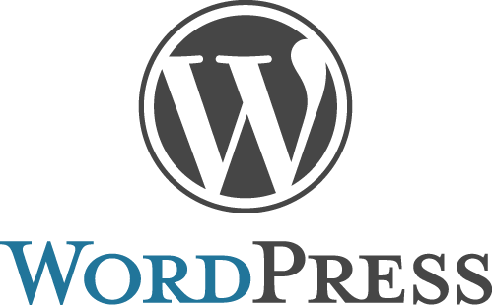
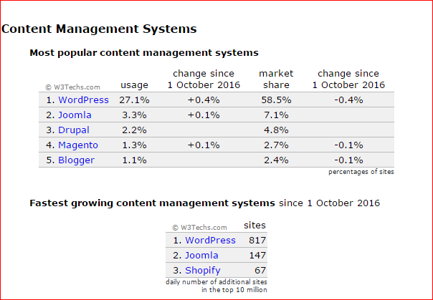


Major Content Management Systems

Slide 7
CMS Comparison: Joomla, Drupal and Wordpress
Which content management system is the best choice for you?
All Joomla, Drupal and Wordpress are open-source software, each developed and maintained by a community of thousands, and all are free to download and use.
The open-source format means that their platforms are continuously being improved to support new Internet technologies, and basic functions can be continuously enhanced with an ever-expanding array of add-ons, contributed from their respective communities.

Slide 8
CMS Comparison: Joomla, Drupal and Wordpress
Your choice depends on your goals, technical expertise, budget and what you want the site to do.
For a simple blog or brochure-type site, WordPress could be the best choice (while very friendly for non-developers, it’s a flexible platform also capable of creating very complex sites).
For a complex, highly customized site requiring scalability and complex content organization, Drupal might be the best choice.
For something in between that has an easier learning curve, Joomla might be the answer.

Slide 9
CMS Comparison: Joomla, Drupal and Wordpress
 | Drupal | Joomla | WordPress
Homepage | www.drupal.org | www.joomla.org | www.wordpress.org
About | Drupal is a powerful, developer-friendly tool for building complex sites. Like most powerful tools, it requires some expertise and experience to operate. | Joomla offers a platform between the developer-oriented, extensive capabilities of Drupal and the user-friendly but more complex site development options that WordPress offers. | WordPress began as an innovative, easy-to-use blogging platform. With an ever-increasing repertoire of themes, plugins and widgets, this CMS is also widely used for other website formats also.
Example sites | Community Portal: Fast Company, Team Sugar | Education: Harvard University Restaurant: IHOP | Education: Hunter Business School NASA Ames Research Center Social Networking: PlayStation Blog News Publishing: CNN Money The New York Observer

Slide 10
CMS Comparison: Ease of Use
 | Drupal | Joomla | WordPress
Ease of use | Drupal requires the most technical expertise of the three CMSs. However, it also is capable of producing the most advanced sites. With each release, it is becoming easier to use. If you’re unable to commit to learning the software or can’t hire someone who knows it, it might not be the best choice. | Joomla is less complex than Drupal but more complex than Wordpress. It has a relatively uncomplicated installation and setup. With a relatively small investment of effort into understanding Joomla’s structure and terminology, you have the ability to create fairly complex sites. | Technical experience is not necessary; it’s intuitive and easy to get a simple site set up quickly. It’s easy to paste text from a Microsoft Word document into a WordPress site, but not into Joomla and Drupal sites.

Slide 11
CMS Comparison: Features
 | Drupal | Joomla | WordPress
Features | Drupal is known for its powerful taxonomy and ability to tag, categorize, and organize complex content. | Joomla is designed to perform as a community platform, with strong social networking features. | Ease of use is a key benefit for experts and novices alike. WordPress is powerful enough for web developers or designers to efficiently build sites for clients; then, with minimal instruction, clients can take over the site management. WordPress is known for an extensive selection of themes. It’s user-friendly with great support and tutorials, making it great for non-technical users to quickly deploy fairly simple sites.

Slide 12
CMS Comparison: Best Use Cases
 | Drupal | Joomla | WordPress
Best use cases | Drupal is best for complex, advanced, and versatile sites; for sites that require complex data organization; for community platform sites with multiple users; and for online stores. | Joomla allows you to build a site with more content and structure flexibility than WordPress offers, but still with fairly easy, intuitive usage. It supports e-commerce, social networking, and more. | WordPress is ideal for fairly simple web sites, such as everyday blogging and news sites; and for anyone looking for an easy-to-manage site. Add-ons make it easy to expand the functionality of the site.

Slide 13
Exercise
Download and install Wordpress from https://wordpress.org/download
Installation Guide: https://codex.wordpress.org/Installing_WordPress
If you are installing on WAMP, detailed instructions for Wordpress installation can be found at http://www.wpbeginner.com/wp-tutorials/how-to-install-wordpress-on-your-windows-computer-using-wamp/
Complete the “First Steps” tutorial at https://codex.wordpress.org/First_Steps_With_WordPress up to the “Customizing Your WordPress Site” section.
In the section “Setting Up Your Site” think of an idea for your CMS, not necessarily the example provided in the tutorial.

Slide 14
Exercise
Continue working on the “First Steps” Tutorial:
Find, download and install a WordPress Theme
Find and install one or more plug-ins of your choice
Test your WordPress site from multiple devices.

